Slide 1
Air quality Analysis and prediction in Tamil Nadu

Slide 2
ABSTRACT
This data science project aims to analyze and visualize the air quality in Tamil Nadu using advanced data analysis and machine learning techniques .Air quality is a critical environmental factor that directly impacts public health and quality of life. In recent years, the deteriorating air quality in various regions has become a major concern. The project begins by collecting a comprehensive dataset that includes historical air quality measurements, meteorological data of different regions within Tamil Nadu. Data preprocessing techniques are applied to clean and integrate the diverse data sources for analysis. As a result we can predict the air quality in Tamil Nadu.

Slide 3
OBJECTIVE:
The primary objective of the Air Quality Analysis project is to utilize data science techniques to comprehensively assess air quality and identify pollution hotspots in a region. It aims through analyze the air quality with the following objective such as Pollution hotspot Identification ,Air Quality Trends Analysis , Health Impact Assessment, Predictive Modeling ,Environmental Conservation .By doing these above we can finally achieve to analyze the air quality

Slide 4
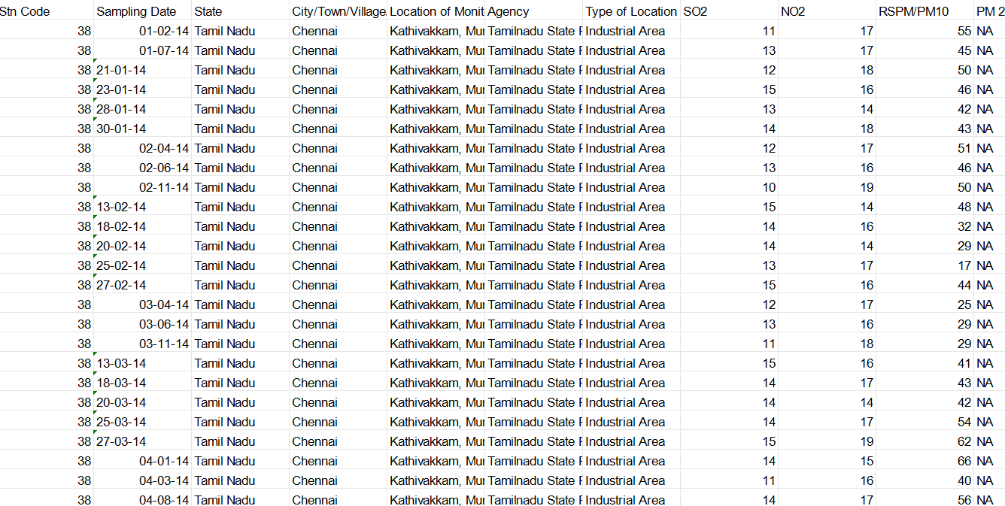
DATA SOURCE:
https://tn.data.gov.in/resource/location-wise-daily-ambient-air-quality-tamil-nadu-year-2014

Slide 5
DESIGN THINKING AND INNOVATION
Data exploration and understanding
Data Preprocessing
Exploratory Data Analysis (EDA)
Predictive Model
Model Evaluation and Selection
Real-Time Air Quality Platform

Slide 6
Data Exploration and Understanding:
Load the dataset into your preferred data analysis tool like python with pandas or R Examine and understand the meaning of each column .
Sampling date – in which date we can predict
State - we predict air quality in Tamil Nadu
City – in which city we can predict the quality of air
Location- in which location we can predict the quality of air
SO2- Amount of so2 present in air
NO2-Amount of NO2 present in air

Slide 7
Data Preprocessing:
Check for the missing Value in each column and row also decide to handle them(Eg: imputation)
Ensure data correctness and consistency , such as all of them within a correct range.

Slide 8
Exploratory Data Analysis
Use statistical techniques and visualizations to gain insights into the data.
Visualize the data to gain insights into its distribution, patterns, and relationships between variables. Visualization can help in the exploratory data analysis (EDA) phase.
Explore the impact of factors such as pollutants, weather conditions, and geography on air quality. This step helps in understanding the drivers of air quality changes.

Slide 9
Predictive Model
Develop machine learning models to predict air quality levels.
Choose appropriate machine learning algorithms for air quality prediction. Common choices include regression models, time series models, neural networks, and ensemble methods.
Identify the most relevant features for predicting air quality levels. Feature selection techniques like feature importance scores can be used.

Slide 10
Model Evaluation and Selection:
Hyperparameter Tuning: Fine-tune model hyperparameters to optimize performance.
Model Selection: Use model selection techniques to ensure that the model's performance is robust and not overfitting the training data.
Choose the most accurate and reliable model(s) based on metrics like RMSE, MAE, and R-squared.
Fine-tune models to improve their predictive power

Slide 11
VISUALIZATION:
Develop informative and visually appearing charts and graphs
Considering creating and interactive visualizing for online sharing or Presentation.
Ensure that your visualizations are well labelled and easy to interpret

Slide 12
Machine Learning and classical Regression Algorithms
Classical regression-based algorithms Regression analysis is used to infer the relation between a dependent variable and a set of independent variables. On the basis of this relation, and using the values of the independent variables, the value of the dependent variable is estimated. Regression helps to predict a continuous value. Next we review classical algorithms to carry out regression.

Slide 13
ALGORITHM USED :
Support vector regression (SVR). Support vector machines are mainly used in classification problems. However, they can be also applied to regression. In this case, the approach is called support vector regression. Let y and x1,…,x p be the dependent variable and the independent variables, respectively. Basically, SVR works as follows. First, a linear regression function, that is, a hyper-plane h(x)=w1x1+…+w p xp + b, must be defined. Then, a margin of tolerance ε is considered, expecting that all data will be at most at distance ε from the hyper-plane. In case the deviation of some points is larger than this value, slack variables ξ,ξ′≥0 can be introduced to cope with them. The final goal is to find the minimum of the function: in(12||w||2+C∑i=1N(ξ + ξ′))

Slide 14
Random Forest (RF). Random Forest is based on the generation of several decision trees. The prediction will be the average of the predictions provided by the different trees. For the construction of each decision tree, a data sample is selected from the training dataset. The rest of the data will be used to estimate the decision tree error. The subset of independent variables that can be used for splitting each node are randomly selected. Extremely randomised trees (ERT) is a slightly modified random forest algorithm. Figure 1b Balogun and Tella (2022) shows a graphical representation of the general structure of a Random Forest Regressor

Slide 15
CONCLUSION:
In conclusion, the "Air Quality Analysis and Prediction in Tamil Nadu" project represents a significant stride towards understanding and mitigating air quality challenges in the region. Through meticulous data collection, thorough preprocessing, advanced data science techniques, and the development of a real-time platform, this project has achieved several critical objective such as accurate prediction , continuous improvement

